Slide 1

HR EMPLOYEE ATTRITION
BY GROUP 5

Slide 2
HR ATTRITION
Introduction
KPI’s
Analysis
Conclusion
Members

Slide 3
Team Members
Aishwarya Raut
Rupal Meshram
Rupali Babhare
Sujata Badaik

Slide 4
INTRODUCTION
Every organization wants its valuable employees to be a part of their organization for a long period. Still, when many employees start leaving the organization, it will be a concern for the organization. The organization should know the possible reasons why their employees are leaving.
In order to determine the potential causes of employee attrition and make the necessary modifications to the organization's rules and working environment, the company will compile data on all of the employees who have left and who are still employed there.
Attrition is the departure of employees from the organization for any reason (voluntary or involuntary), including resignation, termination, death or retirement.

Slide 5
KPI’s
Average Attrition rate for all Departments
Attrition rate Vs Monthly income stats
Attrition rate Vs Year since last promotion relation
Job Role Vs Work life balance
Average working years for each Department
Average Hourly rate of Male Research Scientist

Slide 6
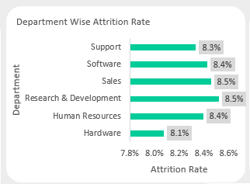
Average Attrition rate for all Departments
Compared to other departments, the research and development department has the greatest attrition rates.

Slide 7
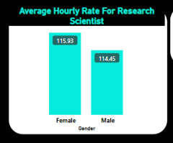
Average Hourly rate of Male Research Scientist
The average hourly working rate for female employee is higher than male employee.

Slide 8
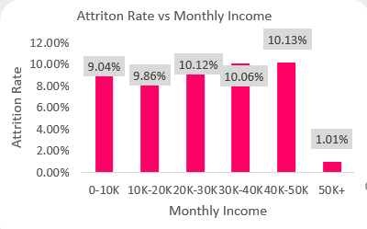
Attrition rate Vs Monthly income stats
The employee with a salary between 40,000 and 50,000 has the highest attrition rate, and the employee with a salary of 50,000 or more has the lowest attrition rate.

Slide 9
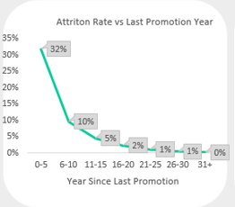
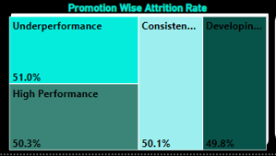
Attrition rate Vs Year since last promotion relation
The most attrition occurs among employees who were promoted during the last five years.
The person who performs poorly leaves the company the most frequently (51%), followed by the employee who performs well.

Slide 10
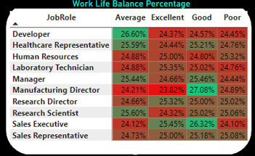
Job Role Vs Work life balance
Compared to other roles, the manufacturing director role offers the good work-life balance, followed by the sales executive role.

Slide 11
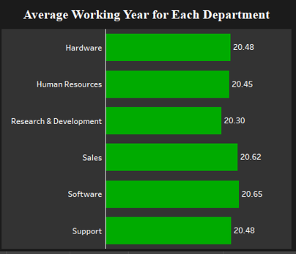
Average working years for each Department
The typical working year for the software department is longer than for other departments.

Slide 12
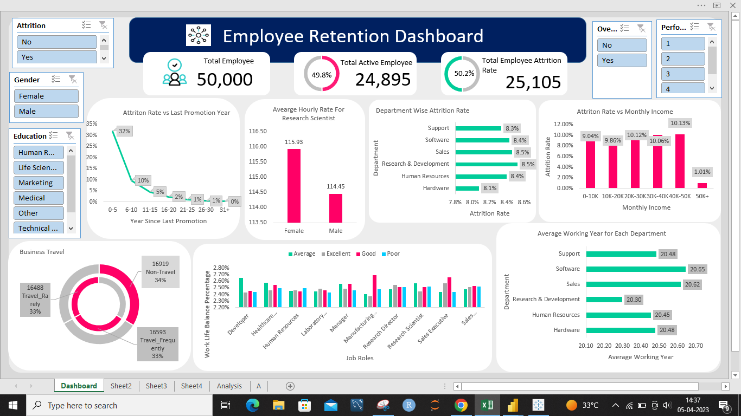
EXCEL DASHBOARD

Slide 13
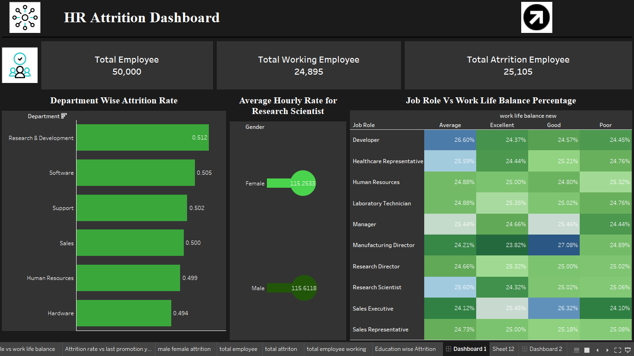
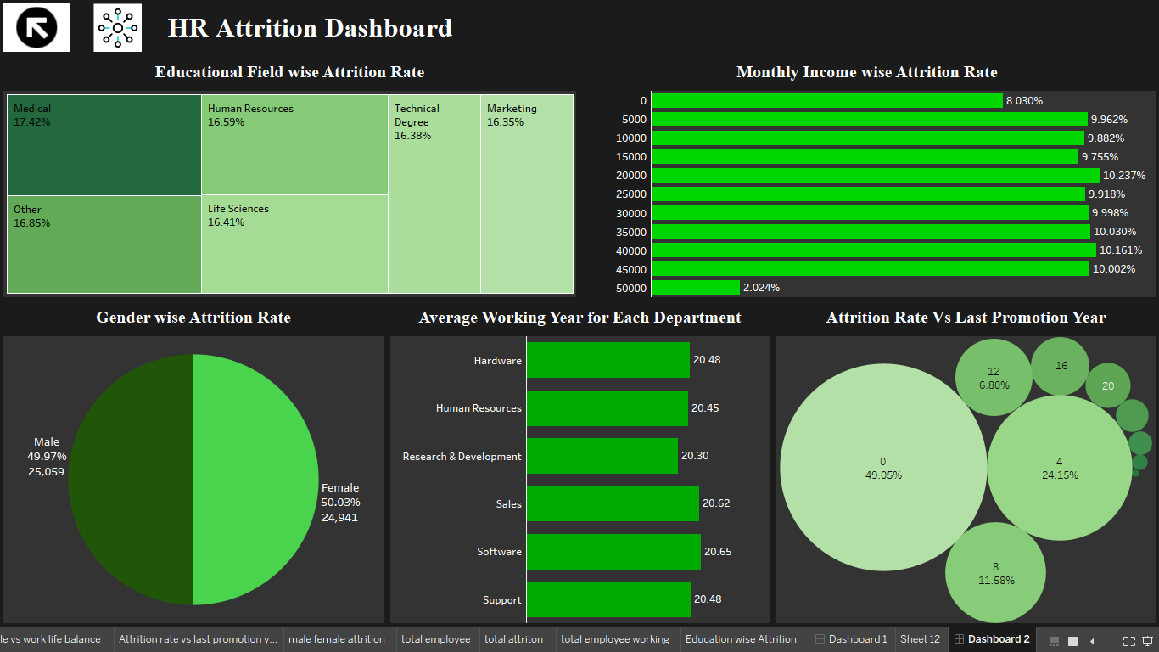
TABLEAU DASHBOARD

Slide 14
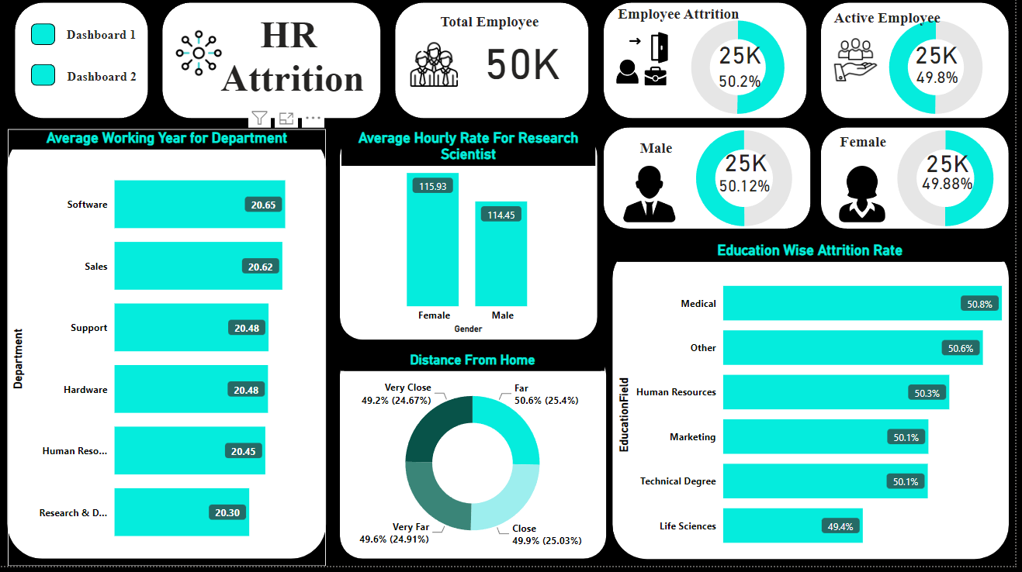
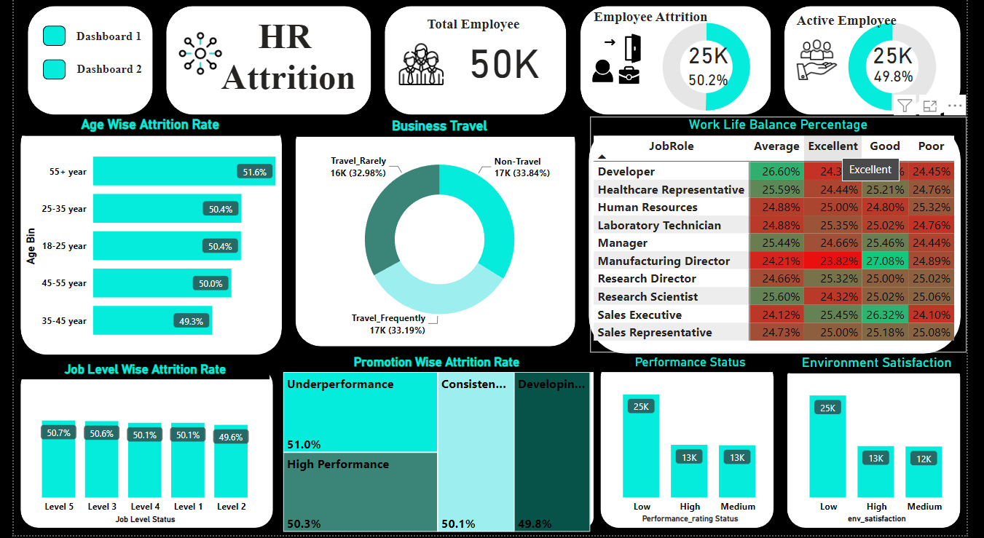
POWER BI DASHBOARD

Slide 15
CONCLUSION
The department responsible for research and development has the highest turnover rate, so we must take steps to prevent employees from leaving the organization.
Salary increases are required to stop employees from leaving the organization.
Due to the retirement age, the employee with an age more than or equal to 55 has the highest attrition rate, so the company needs to hire more people.
The organization should set up training and idea-generating sessions to improve employee performance since underperforming employees are more likely to be terminated.
Employee dissatisfaction with the workplace environment should encourage the organization to take the required steps to improve it.
The organization should attempt to provide travel options or hire candidates who live nearby because the employee with the greatest distance from home has the highest attrition rate.

Slide 16
SWOT Analysis
POSITIVE
NEGATIVE
STRENGTH
WEAKNESS
Using Power BI and Tableau was very efficient in generating the required analytics to meet the required KPIs
Using Maps to compare geographical data for better statistics and representation.
Data quality and Accuracy
Lack of additional data on customer and product like e.g. product ship date.
INTERNAL
OPPORTUNITY
THREAT
Better data quality could help in increasing the report accuracy and decrease data cleansing efforts.
With additional user data like Product ship date or shipping mode, the analysis can be enriched with better statistics and information.
More amount of data could help in forecasting and predictive analysis
Inaccuracy/variation of output due to data quality
EXTERNAL

Slide 17
Thank You

